Slide 1
Introduction to Catalog Management ECM 100 ERICSSON CATALOG MANAGER R14.1
Ericsson OSS/BSS Education Services
January 2015

Slide 2
Copyright
All materials associated with this course are the licensed property of Ericsson.
Possession and/or use of this material is subject to the provisions of a written agreement with Ericsson
Copying or distributing the material is strictly prohibited without prior permission of Ericsson OSS/BSS Education Services

Slide 3
Housekeeping
Training protocols
Phones to silent
Received calls taken outside the training room
Personal laptops closed unless required for training
Promptness when returning from breaks
No smoking
In case of fire
Location of rest rooms
Arrangements for refreshments and lunch

Slide 4
Introductions
Name
Job title and role
Length of time in this role
Experience with Ericsson and equivalent products
Experience in telecommunications
Expectations from this training

Slide 5

Course overview
Description
1-day course providing an introduction to the Ericsson Cataloger Manager functionality
Overview of the Catalog Management Data Model and User Interface
Creation of Catalog Elements as a set of Attributes, Components, Associations, Charge Types, Contexts, Catalog Hierarchies and Rules
Other topics of discussion include Product and Offer versioning, and Catalog Management best practices
Extensive exercises for exploring and practicing the defined activities
Audience
ECM End Users, Product Managers, or Business & Marketing personnel who wish to understand the Catalog Model
Student prerequisites
Understanding of Catalog Management concepts and of TMF SID

Slide 6
Course objectives
By the end of this course you will be able to
Navigate the Ericsson Catalog Manager Administration and Catalog Designer GUIs
Work with Projects, Code Tables, Attribute Types, Items, Item Groups, Charge Types, Contexts and Catalog Hierarchies in the Catalog Designer GUI
This training package is intended to get you immediately started on the Ericsson Order Care® Product Catalog Template
It does not attempt to train you on all features and capabilities
For this purpose please refer to the product documentation

Slide 7
Course schedule
Morning
Ericsson Catalog Manager Overview
Catalog Management Functionality Demo
Projects
Attribute Types
Items and Associations
Building Products
Catalog Hierarchy
Afternoon
Test Catalog App, Context Variables
Rules
Charge Types
Conditional Charges

Slide 8
Associated documentation
The following materials are provided for this course
Hard copy of the presentational slides
Student Exercise document

Slide 9
Course structure
Catalog Manager Overview
Catalog Manager Configuration
Catalog Designer
Code Tables and Attribute Types
Component Items and Associations
Catalog Hierarchy
Pricing
Context Attributes and Rules
Conditional Charges
Notes:
Overview
Template Installation
Product Modeling
Attribute Types
Code Tables
Items
Restrictions
Catalog Hierarchy
Item Groups
Rules
Pricing Rules
Availability Rules
Pricing
Charge Types
Conditional Charges
Discounts

Slide 10
COURSE PROGRESS
Catalog Manager Overview
Catalog Manager Configuration
Catalog Designer
Code Tables and Attribute Types
Component Items and Associations
Catalog Hierarchy
Pricing
Context Attributes and Rules
Conditional Charges

Slide 11
CATALOG MANAGER OVERVIEW
Conceptual Model
Catalog usage benefits
Client and server applications
Items and Associations
Catalog Element status
Projects and their states
Shopping basket
Inheritance
Care Catalog model

Slide 12
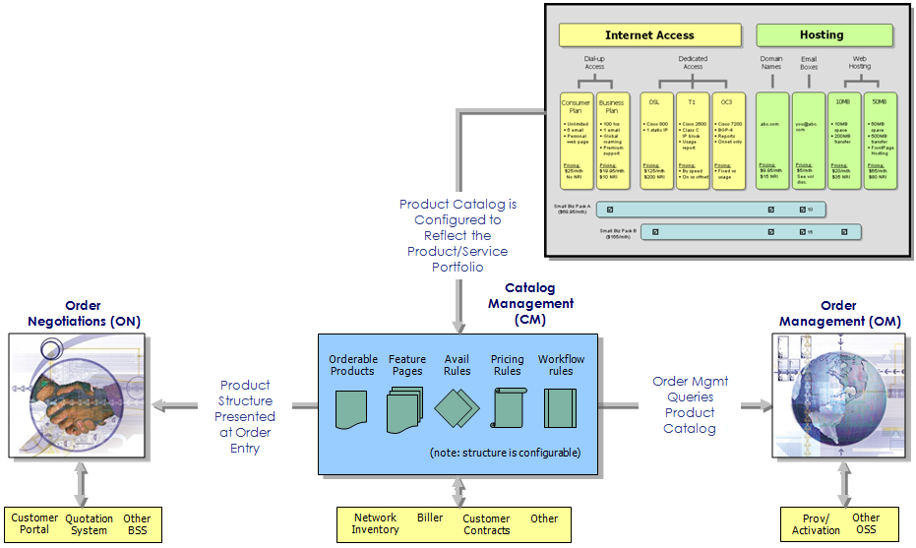
Conceptual Model
A catalog is a repository of information about Items
That repository can be drawn on by various systems

Slide 13
What Does It Do?
Modeling of Products and Services
No restriction on nature or quantity
Permits modeling of base components that are re-useable across products
Out-of-the-box solution
May be used as-is; no programming or extensions are required
Rules Engine
Permits, where required, access to Ericsson Order Care®’s JavaScripting and Integration environments
Pricing Engine
Modeling of simple look-up pricing and complex formula-based pricing
Auto-generated user interface
Full integration with user-interface
Provides Catalog Services to other systems
Web services offered from inquiry through to validation

Slide 14
Benefits of Using the Catalog
Faster Time to Market
New products can be quickly added or changed with minimal IT expertise
Defining Availability and Eligibility
The Catalog provides a one-stop solution for defining both the general market availability and the product's specific eligibility rules.
Support for External Catalogs and Systems
ECM offers the ability to supplement its own information with that contained within external catalogs

Slide 15
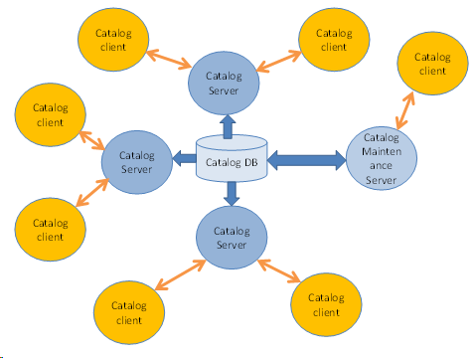
Catalog Architecture
Catalog Server applications have direct access to the Catalog database
Catalog Client applications communicate with the Catalog through Catalog Servers
It is recommended that only one Server maintains the Catalog. All others are only used to access it.

Slide 16
Client and Server Applications
Catalog Client applications may be
CW applications (e.g., ON and OM)
Third party applications (e.g., a billing system)
Catalog Server applications include the Catalog library and customization metadata
The customization metadata may add things like
New APIs
Product lifecycle workflow (using the PLM tool)
It contains rules that cannot be expressed in Catalog Rule language, such as
Rules that need access to data base
Rules that need access to external systems
A Catalog server application maintains a number of caches that contain all the active Catalog elements
This is done for performance reasons

Slide 17
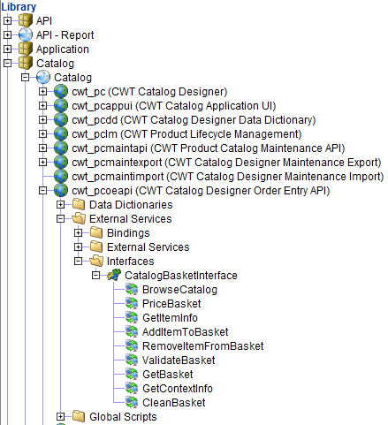
Catalog Server Applications
The Catalog Server application has access to the Catalog through the theCatalog variable
All the Catalog class methods can be run using theCatalog
The Catalog Server application provides Web services that can be used by third party applications
The third party Catalog clients communicate with the Catalog through a SOAP interface
There are two sets of SOAP APIs
Basket-related APIs (right)
Catalog maintenance APIs (next slide)

Slide 18
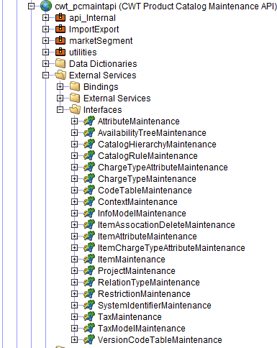
Catalog Server Applications
The Catalog can be maintained through these SOAP APIs

Slide 19
Items and Associations
Items represent the products and services that the company offers
They can be associated with other Catalog elements
Rules
Charges
Attributes
Item
Item
Item
Item
Images
Descriptions
…

Slide 20
CATALOG ELEMENT STATUS
Each Catalog Element is assigned a status from Definition to Active
The Catalog Element changes status as it moves along the Product Lifecycle Management (PLM) different phases
Once Active, a Catalog Element cannot be modified or deleted
Versioning should be used to effect any changes
Version 1
Definition
Developed
Tested
…
Active
Version 2
Definition
Developed
Tested
…
Active
…

Slide 21
Projects and their States
Projects are used to control changes to the Catalog definition
An open project is required for any changes to the Catalog
A Project state change propagates to its members
Project X
Project X
Project X
Project X
Definition State
Developed State
Tested State
Active State
Charge Types
Charge Types
Charge Types
Charge Types
Items
Items
Items
Items
…
Rules
Rules
Rules
Rules
Attribute Types
Attribute Types
Attribute Types
Attribute Types
…
…
…
…

Slide 22
Shopping basket
Defines what products and services a given customer has and/or wants to have.
Created and populated by the Order Entry
Service Registry
Item 1
John
Existing Services
…
Catalog
Order Negotiation
Basket
Order
Item 1
Basket ID
Item 2
Customer ID
…
…

Slide 23
Inheritance
Items can extend other items inheriting all their associations (attributes, charges, …etc.)
Rules
Charges
Attributes
Item A
Item
Images
Descriptions
Rules
Charges
Rules
Charges
Rules
Charges
Attributes
Item B
Item
Attributes
Item C
Item
Attributes
Item D
Item
Images
Descriptions
Images
Descriptions
Images
Descriptions

Slide 24
Care Catalog Model
Product Type (e.g., Pre/Post)
Subscription
MSISDN
Contains
Scope
Rules
Network Facing Services
Offer
Contains
Charges
Product
Contains
Component

Slide 25
COURSE PROGRESS
Catalog Manager Overview
Catalog Manager Configuration
Catalog Designer
Code Tables and Attribute Types
Component Items and Associations
Catalog Hierarchy
Pricing
Context Attributes and Rules
Conditional Charges

Slide 26
CATALOG MANAGER Configuration
Prerequisites
Define a base application
Configuration
Configure Project
Add the Common and Catalog Templates
Establish Users and Privileges
Create an Organizational Chart
Place Users in the Organizational Chart
Catalog configuration
Exercise

Slide 27
prerequisites
Software
Ericsson Order Care® installed (with license key)
In the modules directory (<product_installation_folder>\modules)
catalog.jar catalogClient.jar
cwl_pscm.jar cws_pscm.jar
ecm.jar pscm.jar
serviceOrchestrationFramework.jar SIDCommon.jar
Application Server
Oracle 10g or later
Database schema (see Ericsson Order Care® Installer User Guide)
All core CW DDLs applied
Knowledge
OC200 Service Designer

Slide 28
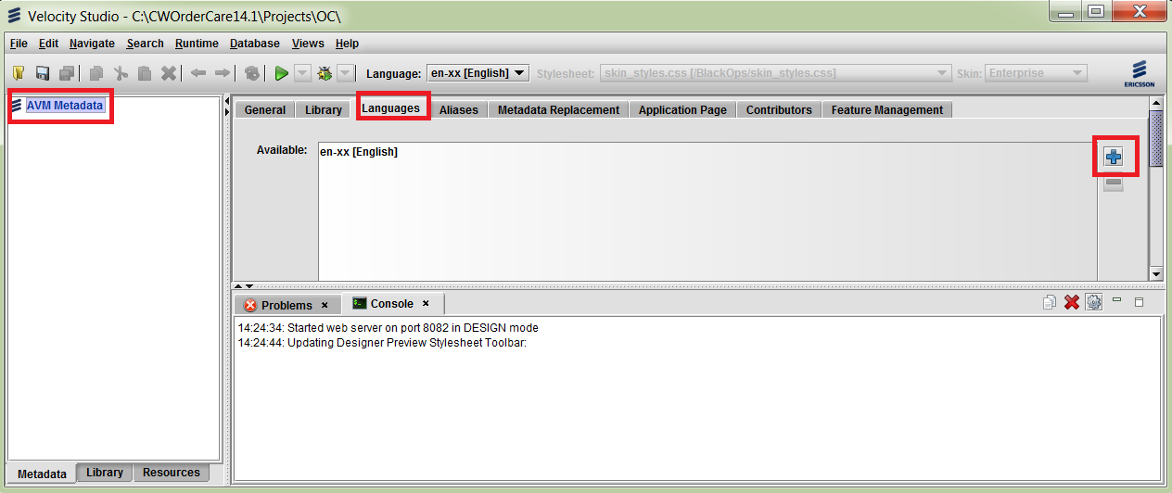
Define a Base Application
Create a new Project and a new Namespace
Only required if starting from scratch
Select the metadata and add a language using the button
Save the metadata

Slide 29
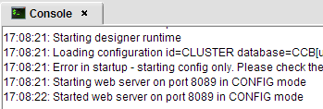
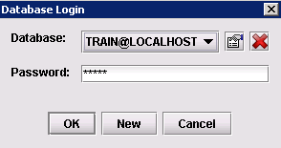
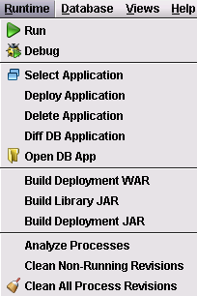
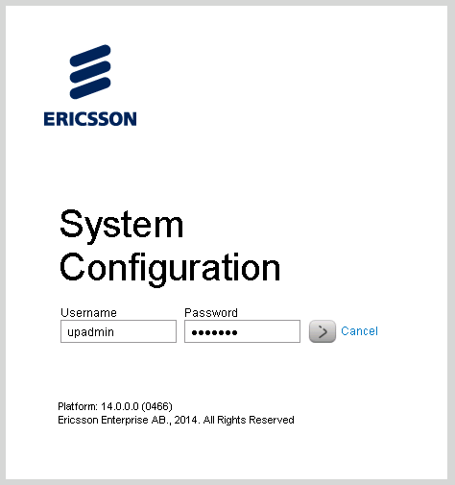
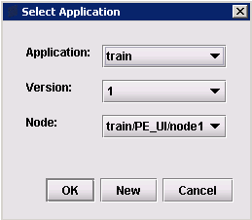
Configuration
Run the built-in Application Server
Provide the database connection info
Select the Application
Open a web browser and log into the Config Tool console via the web address: http://localhost:<port>/cwf/config
To determine the correct port refer to the Console tab in the Notifications pane
Login as upadmin/upadmin

Slide 30
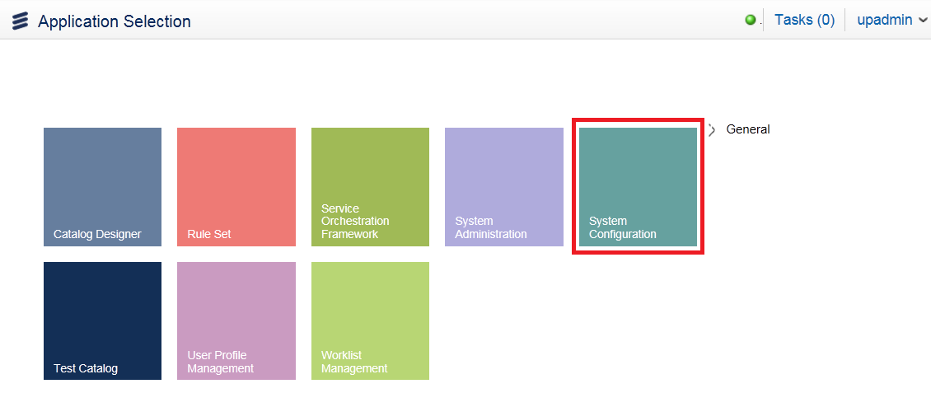
Configuration
Alternatively you can also use the web address: http://localhost:<port>/cwf/selectApp
Sign into System Configuration App

Slide 31
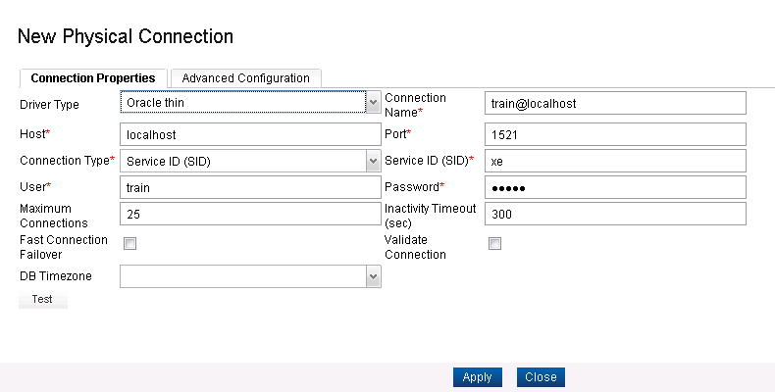
Configure Project
Navigate to the Databases horizontal tab and then to Physical Connection tab
Create a New Physical Connection by clicking on the Add menu option. Enter a name for the physical connection
Enter the settings of the physical connection and click Apply in the dialog box, and Close when done

Slide 32
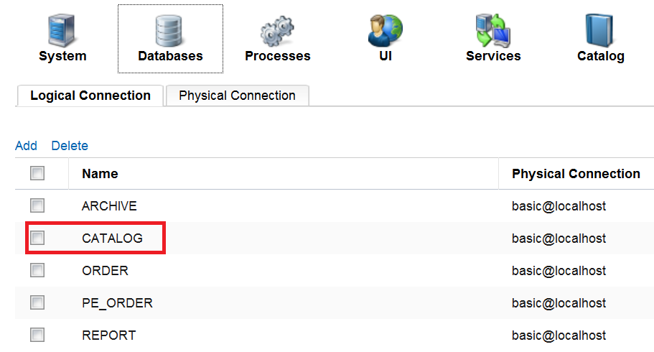
Configure Project
Click on the Logical Connection horizontal tab
Add a new CATALOG logical connection if necessary
Assign all existing logical connections to the physical connection you have created, by double-clicking on each entry and selecting choice from dropdown list
Click on the Save button in the left panel

Slide 33
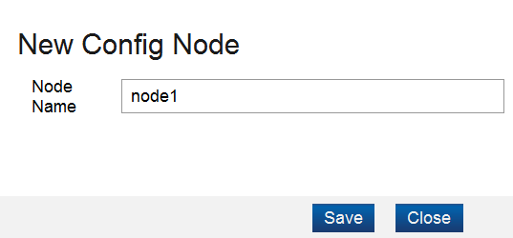
Configure Project
Click on trainingMetadata/PE_UI
Click on + to add node under PE_UI
Enter a name (e.g. node1)
Click Save
Save Configuration

Slide 34
Configure Project
At this point, your Ericsson Order Care® installation is complete. You can now create your new application metadata or load an existing metadata, and then run it
In a Windows environment, the standard output and error for Service Designer are redirected to \CWOrderCare\designer\env\log

Slide 35
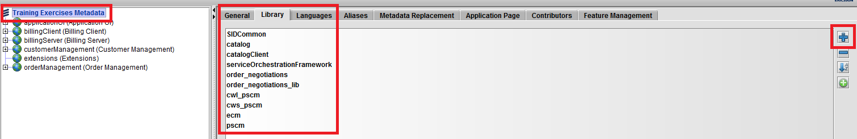
Add the Common and Catalog Templates
Go back the Service Designer and select the metadata
Click the Library tab
Use the button to add the Catalog, CatalogClient, serviceOrchestrationFramework and SIDCommon annd other required libraries
Reload your project
From that Modules\Catalog\DDL directory on the installation directory, run the catalog.sql DDL against the database
Select Database -> Upgrade System and run the resulting DDL (if any) against the database

Slide 36
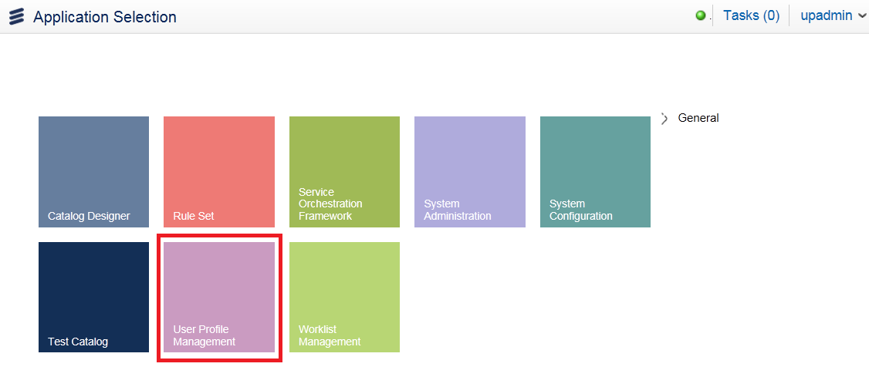
Establish Users and Privileges
Login to the User Profile Manager

Slide 37
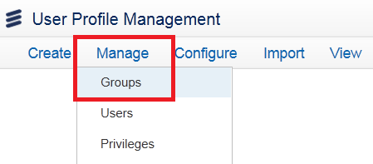
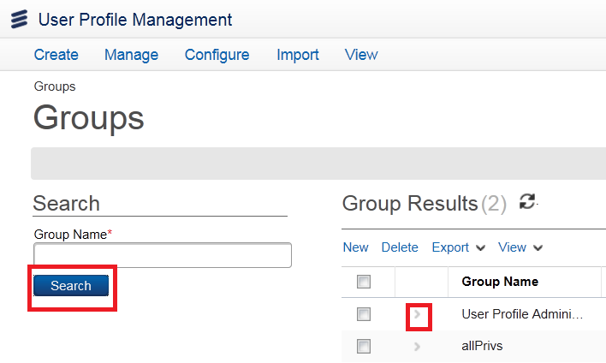
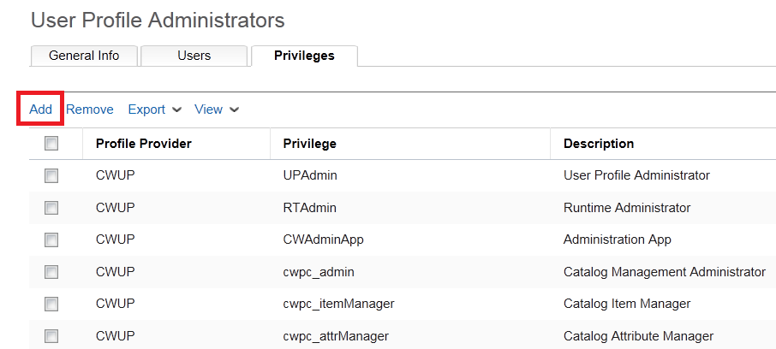
Establish Users and Privileges
Go to Manage>Groups
Grant All Administration rights to User Profile Administrators
Add all Privileges to the Group User Profile Administrators

Slide 38
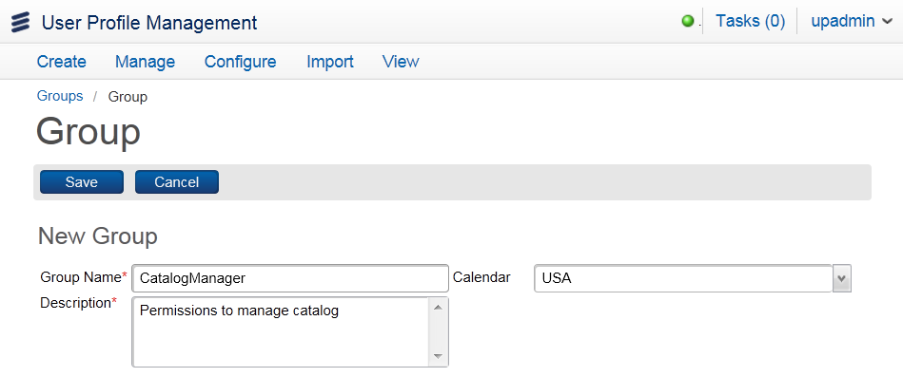
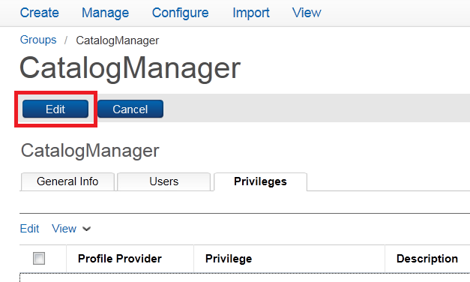
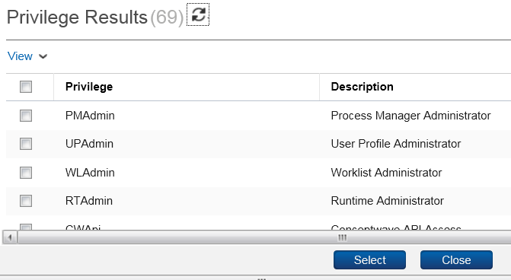
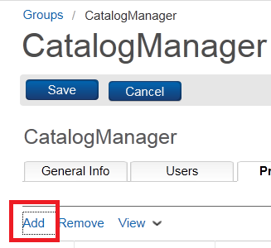
Establish Users and Privileges
Create a Catalog User
Create a Group called Catalog Managers
Grant all Catalog and UP Admin privileges to this Group

Slide 39
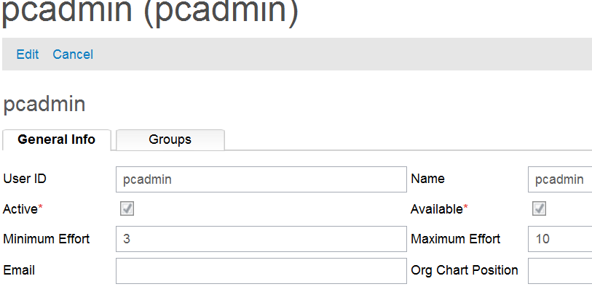
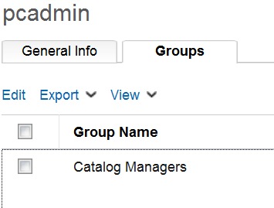
Establish Users and Privileges
Create a Catalog User
Create a user pcadmin and assign to the Catalog Managers Group

Slide 40
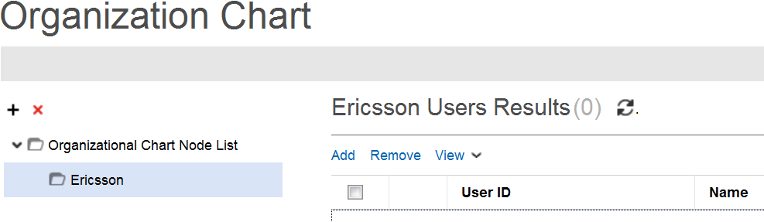
Create an Organizational Chart
To Create the Org Chart root, Select the Manage menu and Organizational Charts node, and click the + icon
Enter a Name and click the Save icon (Ex. Ericsson)

Slide 41
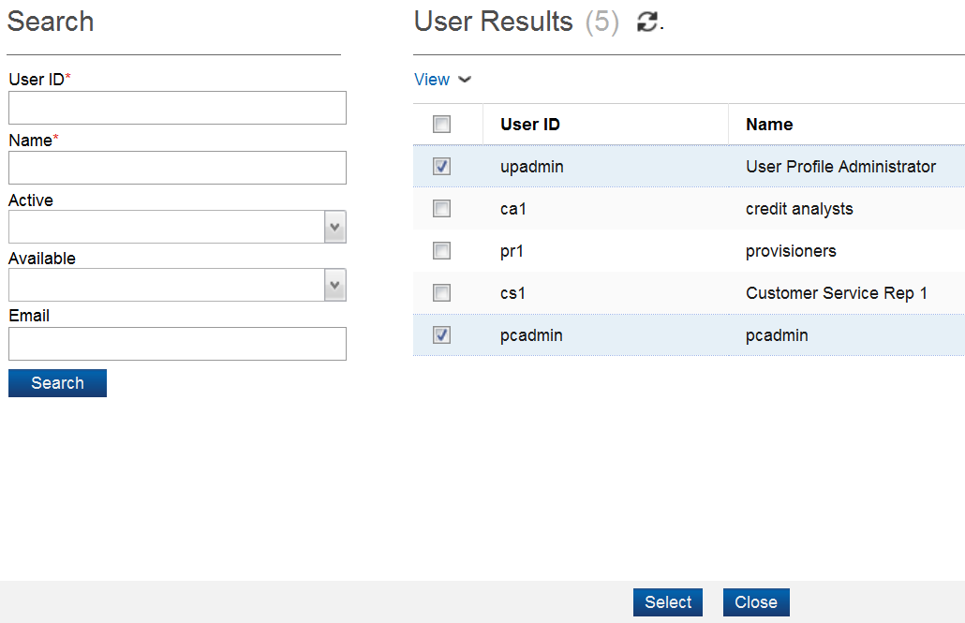
Place Users in the Organizational Chart
Click Add in Central Navigation
Select the pcadmin, upadmin and any other user to manage catalog
Click Select

Slide 42
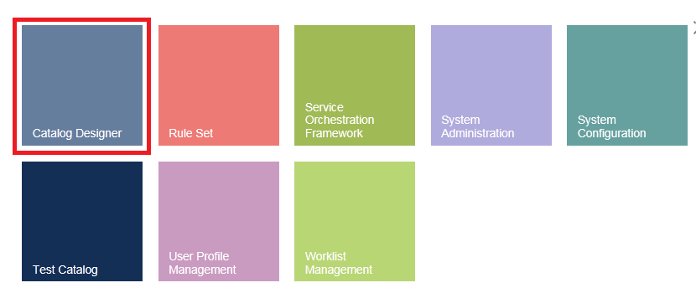

Catalog Configuration
Login into Catalog Management
Login as the Product Manager
If prompted for an application, select Catalog Designer
Select Administration-> Catalog Configuration in the Quick Start Menu

Slide 43
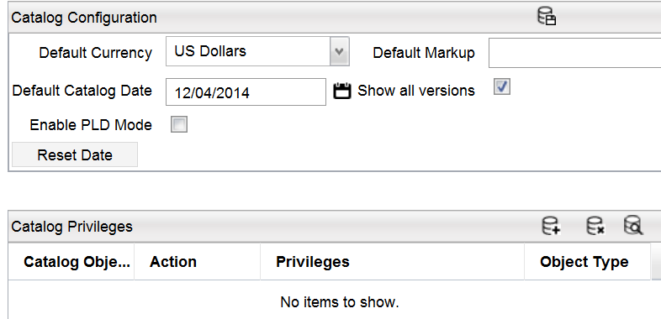
Catalog Configuration
Default Currency: In the case of no currency being specified at the element level, an element will default to this currency
Default Markup: In the case of no values given at the element level, an element will default to this value
Default Catalog Date: Select a default date that the currency and markup values take effect
Save using the button
Note: The Default Catalog Date may have to be removed for testing purposes

Slide 44

exercise
The instructor will now lead you through Exercise 1
This will provide you with some hands-on experience with the following topics
Create an organizational chart (top level)
Add subsidiary nodes
Assign users to different chart positions
Configure default currency, markup and date
You will use the separate exercise document provided with these slides
Ericsson Catalog Manager 14.1 ECM100 Student Guide

Slide 45
COURSE PROGRESS
Catalog Manager Overview
Catalog Manager Configuration
Catalog Designer
Code Tables and Attribute Types
Component Items and Associations
Catalog Hierarchy
Pricing
Context Attributes and Rules
Conditional Charges

Slide 46
CATALOG DESIGNER
Catalog Designer menu
Create a Project
Open Project
Create new Elements
Change Control
Project status
Versions
Exercises

Slide 47
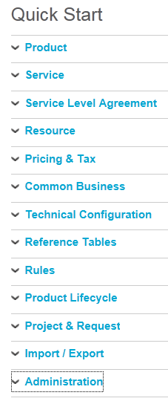
Catalog Designer Quick Start Menu
This is where you go to
Create new Catalog Elements
Search for existing Catalog Elements
Modify or Delete existing Catalog Elements

Slide 48
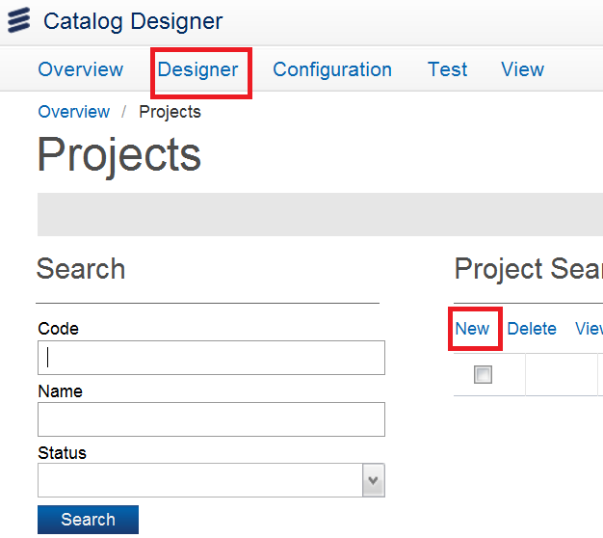

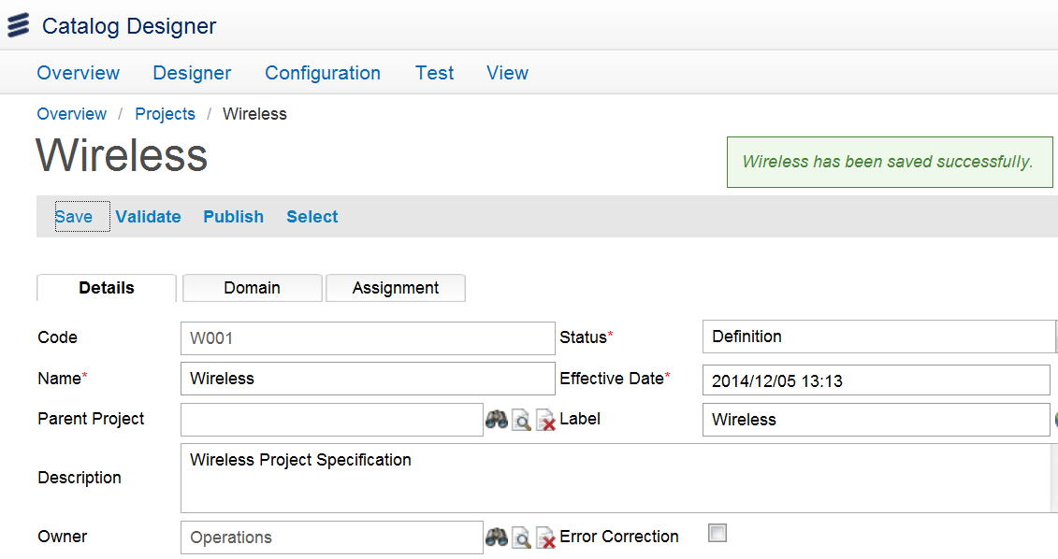
Create a Project
To create a new Project, click Project under Project & Request from the Quick Start Menu and select New in Central pane
Provide the Project details and click Save
Project Code: Identifies the Project uniquely

Slide 49
Create a Project
Status: The default status is Definition. Changing the status to Active results in all Catalog changes that reference this project to be also committed
Effective Date: The Project changes are effective on this date/time once the project is committed (i.e., status is Active)

Slide 50
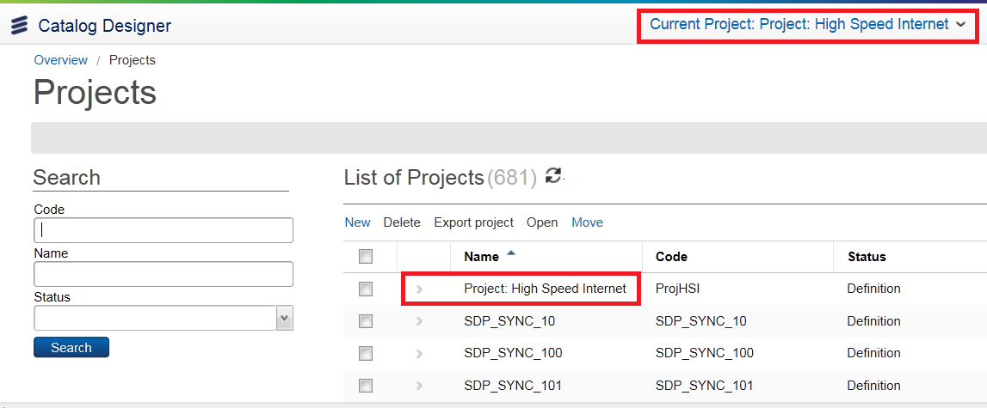
Open Project
Click on the project to host the changes you intend to make
Select the Project to be opened and then click the >
The Project Code will appear in the top right-hand corner of all pages

Slide 51
Create New Elements
When creating an element within a Project
Only one version of the element can be created in a project
Only one project in a development stage can change a given Catalog element
If the new element doesn’t have a start date
The start date is set to the project effective start date at time of activation
A new element start date should not be earlier than the project effective start date
Changing the Project status changes that of all of its constituent elements
This ensures that the changes will become visible for all Catalog client and server applications at the same time

Slide 52
Change Control
Catalog elements fall into four major groups
Items – Catalog items and their associations
Catalog hierarchy tree elements – tree nodes, tree node children, and tree node items.
Non-versioned elements : attribute types, association types and Catalog context type.
Versioned elements – All other elements except items and item associations.
The change control mechanism is implemented through projects
Projects are groups of elements
The elements of the projects as well the projects themselves have a status attribute
All Catalog elements have life span with start and end date

Slide 53

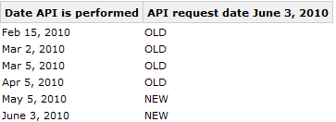
Project Status
The example below shows the Catalog behavior for a project which makes changes to an existing item “ITEM”
Four types of dates are at play here
Activation date: The date changes are committed
Effective date: The data the changes become visible to the Catalog users
API-performed date: The date the request is received by the Catalog server
API-request date: The date of interest as specified in the request

Slide 54
Versions
Activated Catalog Elements are unchangeable
Changes can be done to new versions of the Catalog Elements
Both old and new versions are kept
The version to use is determined based on the API request time
Activated new versions need about 30 minutes to be visible to users

Slide 55
Exercises
The instructor will now lead you through Exercises 2-3
This will provide you with some hands-on experience with the following topics
Navigate the Catalog Designer GUI
Find information in the Catalog Designer GUI
Create a new Project and add details
Open the new Project
You will use the separate exercise document provided with these slides
Ericsson Catalog Manager 14.1 ECM100 Student Guide

Slide 56
COURSE PROGRESS
Catalog Manager Overview
Catalog Manager Configuration
Catalog Designer
Code Tables and Attribute Types
Component Items and Associations
Catalog Hierarchy
Pricing
Context Attributes and Rules
Conditional Charges

Slide 57
Code Tables and Attribute Types
About Code Tables
Create a Code Table
Overview of Attribute Types
Create an Attribute Type
Common concepts
Exercise

Slide 58

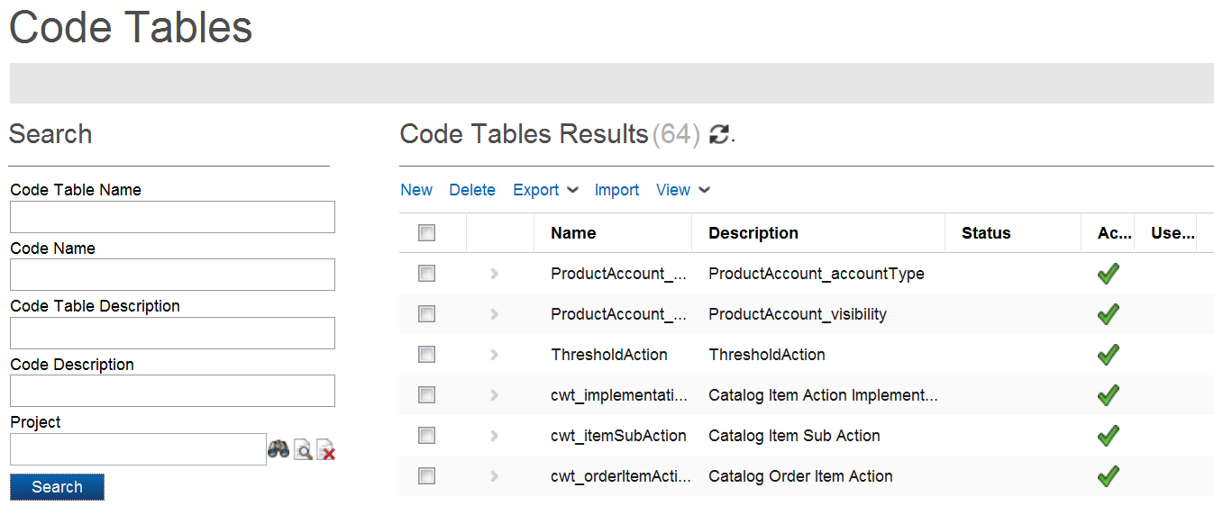
About Code Tables
Permits definition of an “enumerated” set of values
Some are built-in and provided with the Catalogue; can be viewed by clicking on Reference Tables -> Code Table and then Search
Most are modeled by the Product Manager

Slide 59
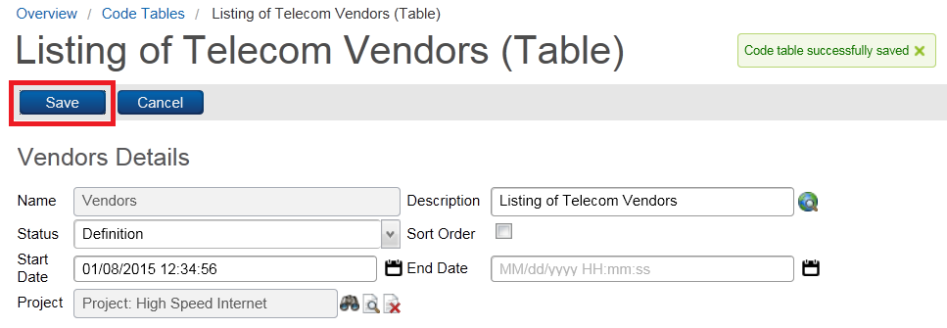
Create a Code Table
To create a code table
Select Reference Tables -> Code Table from Quick Start Menu
Select New
Provide a Name and a Description
Save

Slide 60
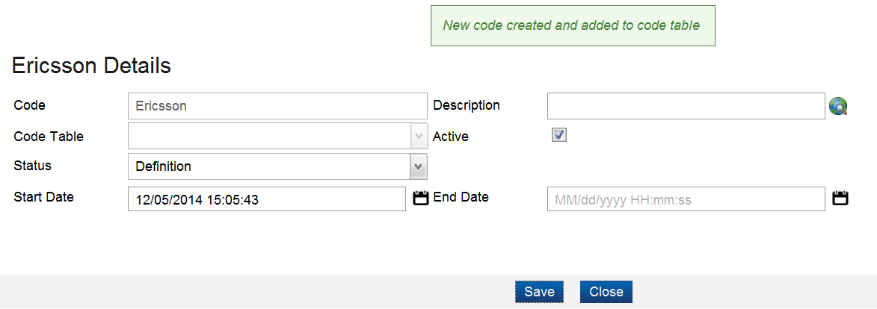
Create a Code Table
To add a code
In the Results section, click New
Enter the code and click Save

Slide 61
Overview of Attribute Types
An Attribute Type is essentially a data type
Every Attribute Type has to be based on some Base Type
Number
String
Date
Boolean
Code Table
Code Table based Attribute Types are used to create drop-down list Attributes
The Code Table would have the options of the drop-down list

Slide 62
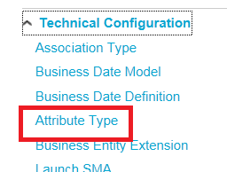
Create an Attribute Type
Click the Technical Configuration->Attribute Type from Quick Start menu
Search: returns results on the search criteria
Add: opens the Attribute Type Detail form to add a new Attribute Type
Detail: opens the Attribute Type Detail form for editing the selected Attribute Type
Show Usage: lists objects containing the selected Attribute Type

Slide 63
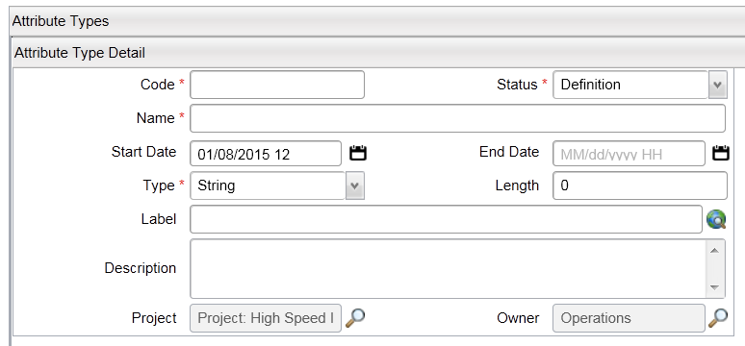
Common Concepts
Code
Mandatory
The code must be a “Java Name”
Label
This is what is visible to the end user
Translatable
Name
Mandatory
Can have spaces and special characters

Slide 64
exercise
The instructor will now lead you through Exercise 4
This will provide you with some hands-on experience with the following topics
Create code table
Export and view code tables
Create bandwidth and string attribute types
You will use the separate exercise document provided with these slides
Ericsson Catalog Manager 14.1 ECM100 Student Guide

Slide 65
COURSE PROGRESS
Catalog Manager Overview
Catalog Manager Configuration
Catalog Designer
Code Tables and Attribute Types
Component Items and Associations
Catalog Hierarchy
Pricing
Context Attributes and Rules
Conditional Charges

Slide 66
Component Items and Associations
Create Items
Create a Product Item
Item Groups overview
Cardinality
Add an Item to an Item Group
Relations
Exercise
Associations
Item Attribute Associations
Base Items
Value Restrictions
Test Catalog App
Exercise
Notes:
Duration: 30 Minutes

Slide 67
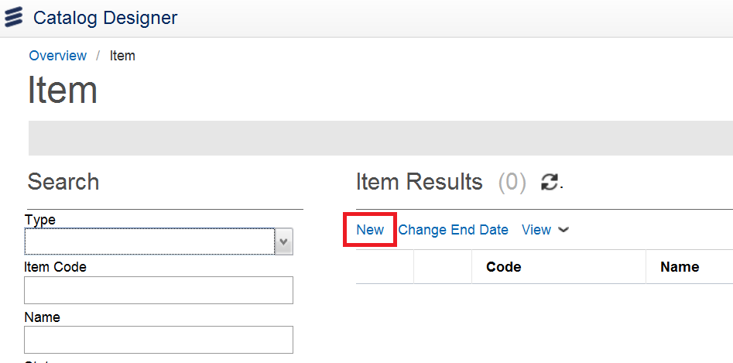
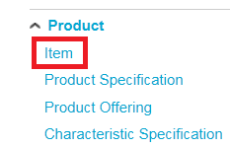
Create a Product Item
From the Catalog Designer Quick Start menu, select Product->Item
Click New in the central pane

Slide 68
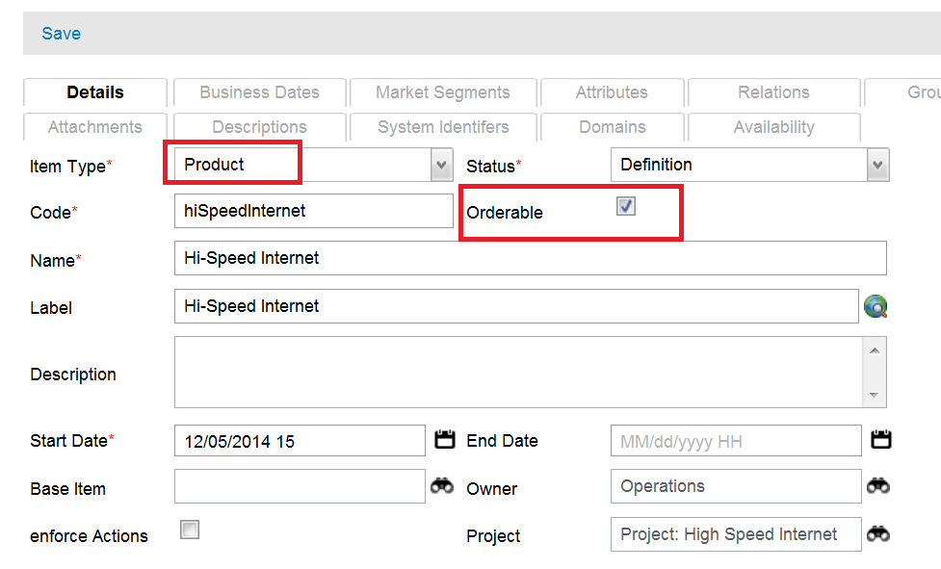
Create a Product Item
Specify a Product as Item Type
Only orderable Items are returned when the Catalog is queried
Non-orderable Items can only be related to other items
Fill in as below and Click Save

Slide 69
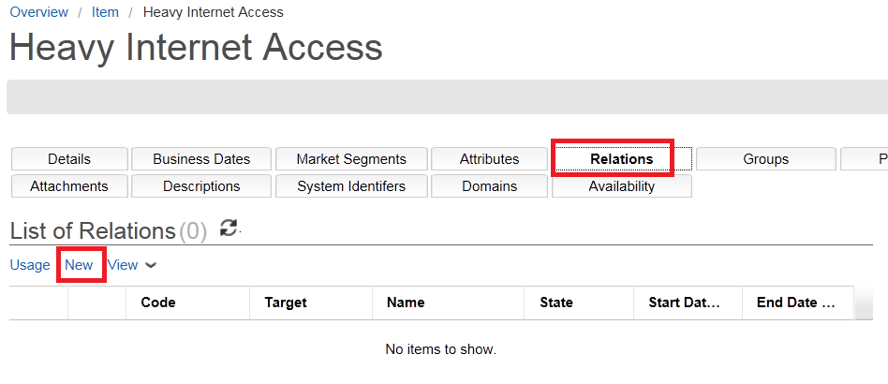
Create a Product Item
A product Item consist of zero or more other Items
These Items may themselves be component or product Items
Select Relations tab and click New
Target: specifies the related Item
Sequence: defines the order of presentation on the order entry form

Slide 70
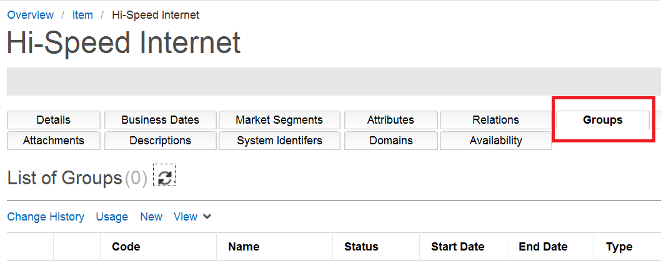
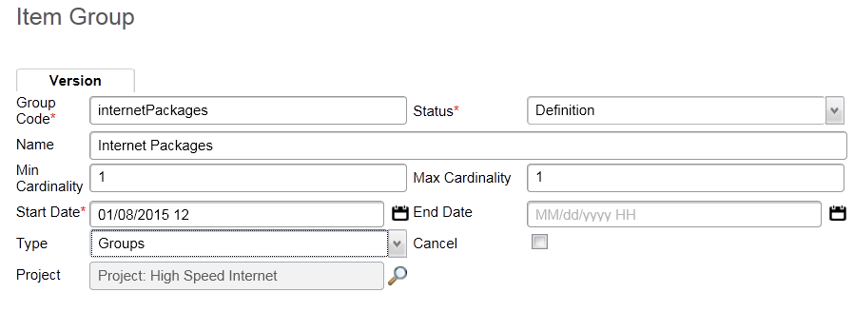
Item Groups Overview
An Item Group is a means to cluster Relations within an Item
Groups could be used to
Form a package (for example, add-on voicemail / call display / call-forwarding package of a VoIP access Product)
Provide selection among Components (for example, choose among various VDSL speeds in high-speed Internet Product)
Provide restriction in pick-and-choose choices (for example, choose up to a maximum of three channels in a theme pack for Digital TV subscription Product) by Clicking on New in central pane

Slide 71
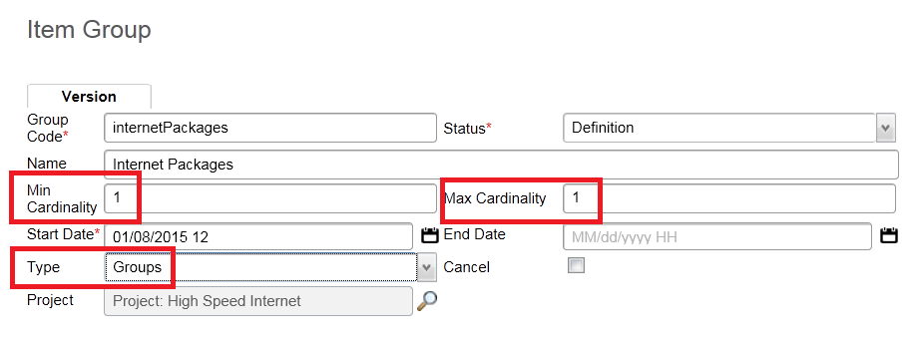
Cardinality
Min/Max Cardinality: determine how many of the Group’s Items may be selected while placing an order. For example
Min = 1, Max = 1 : Only one Item may be selected
Min = 0, Max = 3 : Up to 3 Items may be selected

Slide 72
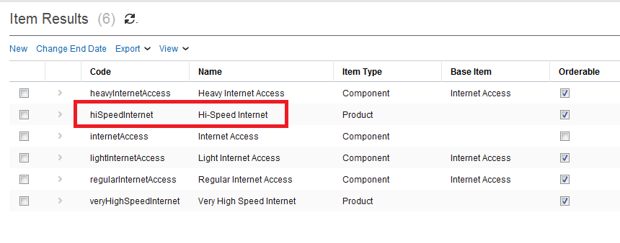
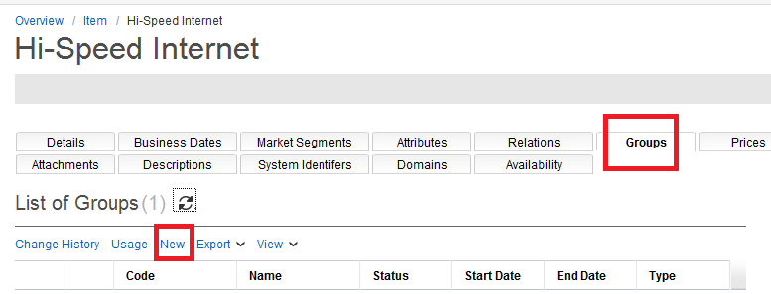
Add an Item to an Item Group
To add an Item to a Group
Select the Item
Select the Groups tab and Click > next to desired group
Select the Targets tab and New

Slide 73
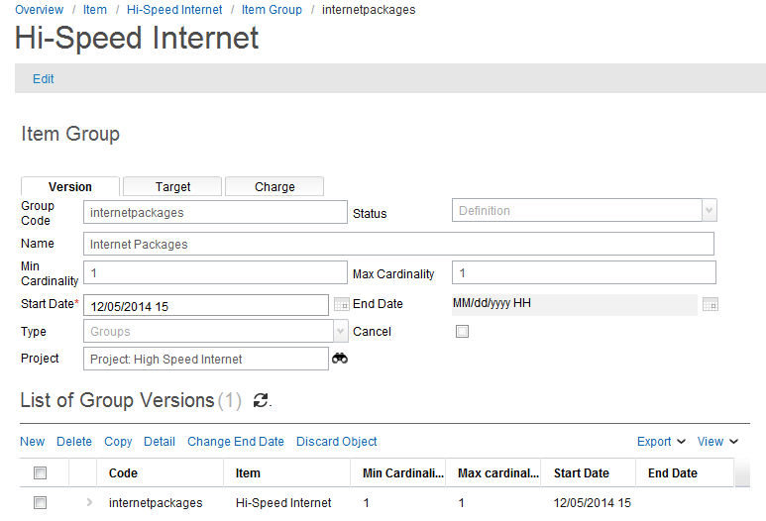
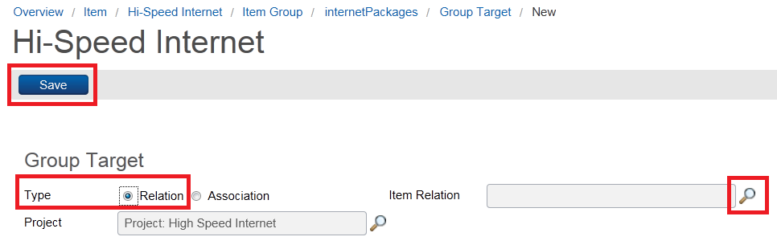
Add an Item to an Item Group
Fill in details of Item Group and click Save
From Target tab
Click New
Check Relation
Click the Item Relation Finder
Click Save

Slide 74

Relations
You can add a number of Relations that have the same Association Type to a Group by specifying that Association Type
This is one of the reason why you might want to create a number of Association Types and assign them to Item Relations

Slide 75
exercise
The instructor will now lead you through Exercise 5
This will provide you with some hands-on experience with the following topics
Create component item and add detail
Create bandwidth attributes and associate with component item
Create more components items and add attribute restrictions
You will use the separate exercise document provided with these slides
Ericsson Catalog Manager 14.1 ECM100 Student Guide

Slide 76
Associations
Associations define all characteristics of the item
There is a predefined set of Association Types but the user can add more if needed
Rules
Charges
Attributes
Item
Item
Item
Item
Images
Attachments

Slide 77

Associations
There is a predefined set of Association Types but the user can add more if needed

Slide 78

Item Attribute Associations
Allows for the definition of properties relating to Catalog items
First an Attribute Type is defined which is then linked to an Attribute association
If it is marked as Is Property, the default value provided cannot be changed in the client applications

Slide 79

Item Attribute Associations

Slide 80

Base Items
Is used by other Items to inherit from
Useful when multiple Items are similar in some aspects
Child Items inherit all of the Attributes, Charges, Rules, and other associations of the parent
For example, a TV channel may be modeled as
A base TV Channel Component that carries language, nationality, theme as properties
Each individual TV channel would extend the base channel and specify the application language, nationality and theme

Slide 81

Base Items
To define a base Item
Define a common Item
Define New item based on common by specifying Base Item
Add any unique attributes
Define the restriction on the inherited attributes / properties

Slide 82
Value Restrictions
Select the Attribute
Under Attribute detail, you may have to Click Edit
Click … button next to Default Value
Click on desired Value from code table

Slide 83


Test Mode
Permits the Product Manager to view and test the changes being made to the catalog
Permits selection of current date
Ignores active flag, i.e. items in define state are presented
Permits Product Manager to impersonate a user, i.e. set the parameters of the end client (residential, lives in Ohio, etc)
Permits control over whether the default Catalog Order, or the application defined default Order, will be used
Once the Test Mode is turned On, you can
Browse the catalog
View the Basket (i.e., ordered Items)
Set the Context Attributes (e.g., city, customer type)

Slide 84
exercise
The instructor will now lead you through Exercise 6
This will provide you with some hands-on experience with the following topics
Create association type and relate items
Create item group and add members
You will use the separate exercise document provided with these slides
Ericsson Catalog Manager 14.1 ECM100 Student Guide
Notes:
Create a Hi-Speed Internet product Item
Specify Start date as Today
Specify it as Orderable
Create a new Item Association Type called Optionally Contains
Add the following component Items to the product Item using the Optionally Contains Association Type:
Lite Internet Access
Regular Internet Access
Heavy Internet Access
Place the product Item in the Residential/Internet portion of the catalog
Test your Catalog:

Slide 85
COURSE PROGRESS
Catalog Manager Overview
Catalog Manager Configuration
Catalog Designer
Code Tables and Attribute Types
Component Items and Associations
Catalog Hierarchy
Pricing
Context Attributes and Rules
Conditional Charges

Slide 86
Catalog Hierarchy
About Catalog Hierarchy
Create a Catalog Hierarchy
Catalog Hierarchy scenario
Exercise

Slide 87

Catalog Hierarchy
A catalog may contain thousands of Items
Catalog Hierarchies are used to classify Items into logical groupings
May be used as a logical catalog for a particular
demographic,
market segment,
product line,
campaign,
… etc.
A single Item may be placed in more than one node within the Catalog Hierarchy

Slide 88

Create a Catalog Hierarchy
To add a folder
Select the parent node
Click Add Hierarchy at the bottom of the window
Enter the hierarchy details
Click the Save button

Slide 89

Catalog Hierarchy Scenario
Create a Catalog Hierarchy
Create two top level catalogs: Public and Private Catalog
Within Public, create two branches: Internet and TV
Create two branches under TV: Digital and Analog

Slide 90
exercise
The instructor will now lead you through Exercise 7
This will provide you with some hands-on experience with the following topic
Create catalog hierarchy
Add item to hierarchy node
Test catalog hierarchy
You will use the separate exercise document provided with these slides
Ericsson Catalog Manager 14.1 ECM100 Student Guide

Slide 91
COURSE PROGRESS
Catalog Manager Overview
Catalog Manager Configuration
Catalog Designer
Code Tables and Attribute Types
Component Items and Associations
Catalog Hierarchy
Pricing
Context Attributes and Rules
Conditional Charges

Slide 92
Pricing
Charge Types
Create a Charge Type
Apply a Charge Type to an Item
Charge Type Versions
Exercise

Slide 93
Charge Types
A Charge Type represent one charge that can be associated with Items
The relationship for Charge Types Pricing and Discounts to Items is a one-to-many relationship
A product may have many price points, for example different prices for hardware or installations (standard or express)
Charge Types use versions to represent different pricing and discount options that are available
You can add conditions to a Charge Type
Conditions are business rules which decide, at run time, which association (version) apply for particular operation, user, shopping basket and service inventory.
A Charge Type can have several versions

Slide 94


Create a Charge Type
Catalog Pricing & Tax -> Charge Type from the Quick Start Menu
Select Add
Charge Frequency
By default, Annual, Biweekly, Monthly, One Time, Semi-Annual
Can be configured in the code table cwtct_chargeFrequency

Slide 95

Create a Charge Type
Fill out details of Charge Type as follows and the Click Save:

Slide 96


Apply a Charge type to an Item
Select the Prices tab for the Item to apply the Charge to
Click New
Click the Charge Type finder icon

Slide 97

Apply a Charge type to an Item
Select the Charge Type
Double-Click, or
Click >
Fill in Label
Click Save
Charges can also be applied to Groups

Slide 98
exercise
The instructor will now lead you through Exercise 8
This will provide you with some hands-on experience with the following topics
Create charge types
Associate charge types with items
Test basket pricing
You will use the separate exercise document provided with these slides
Ericsson Catalog Manager 14.1 ECM100 Student Guide
Notes:
Create the following Charge Types:
A one time Installation charge - $100 CAD
3 recurring monthly Subscription charge (all in Canadian Dollars):
Lite - $20
Regular – $40
Heavy – $60
Apply the installation charge to the product Item
Apply each subscription charge to the corresponding component Item
Testing
Turn Test Mode On
Browse the Catalog, Add the Product to the basket
View the Basket and click the Price button to calculate the pricing

Slide 99
COURSE PROGRESS
Catalog Manager Overview
Catalog Manager Configuration
Catalog Designer
Code Tables and Attribute Types
Component Items and Associations
Catalog Hierarchy
Pricing
Context Attributes and Rules
Conditional Charges

Slide 100
Context Attributes and Rules
Contexts and Context Attributes
Create a Context
Set the Default Context
Rules - overview
Rules - sample statements
Special variables and common operators
Language expression and identifier types
Operations
Create a Catalog Rule
Rule types
Exercise

Slide 101
Contexts and Context Attributes
A Context is a collection of Attributes that hold information provided by some external system such as
Customer’s market segment
Customer’s city or state
Context Attributes are referenced in Catalog Rules
E.g., the availability of an Item could be determined by his/her address
Only one Context could be the current Context at any point in time
Only the current Context’s attributes can be referenced
The scripts within Rules can call a context attribute by predefined object theContext (which refers to the default Context)
E.g. theContext.country

Slide 102



Create a Context
From the Quick Start Menu, select Rules->Context
Can also be selected under Technical Configuration on Overview screen
In the Context Search page, select Add
Provide the Context Details and Save
The Context Attribute tab allows you to define the Attribute information for the Context

Slide 103


Set the Default Context
From the Catalog Designer app, select Rules->Contexts from the Quick Start Menu
Select the desired Context and press Set Context

Slide 104


Set Context Variable value
To provide a value for a Context attribute,
Select Test Mode -> Set Context Attributes
Provide a value for each of the attributes defined
Save

Slide 105

Rules - Overview
Scripts that can return a value
Boolean Rules can be used to conditionally
Make an Item available
Make a charge applicable
…
Numeric Rules can be used to
Calculate the amount of a charge
Determine the ranking of an item
…
Rules are built using the Catalog Rules Language (default) or Java Script

Slide 106

Rules - Overview
Rules come in two flavours
Characteristic Rule: is defined within and only accessible by one Catalog Element (e.g., Charge Type)
Catalog Rule: is global and can be accessed by any Catalog Element
The Rule Language is NOT case sensitive

Slide 107
Rules - Sample statements
select item count from basket variable [where
<item attribute name> operation expression and
<item attribute name> operation expression…]
Example:
If (select item count from theBasket where type equals “PRODUCT”) > 10 then…

Slide 108
Rules - Sample statements
select [single|many] item from basket variable where
<item attribute name> operation expression and
<item attribute name> operation expression…
Example:
Variable Item myItem = select item from theBasket where type = “OFFER”

Slide 109
Rules - Sample statements
select [single] associated/related item from item variable where
<property specification> operation expression and
<property specification> operation expression…
Example:
Variable Item item1, item2;
…
Item1 = select associated item from item2 where type() is “CONTAINS” and code == “HS-001”

Slide 110
Rules - Sample statements
select associated/related match count for literal, literal, … / constant list by attribute name
from item variable [where
<property specification> operation expression and
<property specification> operation expression…]
Example:
If select associated match count for “AA021”, “AA036”, “AA047” by code
from theItem where type == “product” greater or equal 2 then …

Slide 111
Rules - Sample statements
exist[s] [an] item in basket variable where
<item attribute name> operation expression and
<item attribute name> operation expression…
Example:
count = count + 1 when exist an item in theBasket where type == “PROD” and code equals no case “tv”

Slide 112
Special variables and common operators
Special Variables
theBasket – the current user shopping basket. Element of Basket type
theInventory – the current user inventory. Element of Inventory type
theContext – the current user context. Element of Context type
theItem – the selected basket item. Element of Item type
Common Operators
! NOT !A
&& AND A && B
|| OR A || B
== EQUALS A == B
!= NOT EQUALS A != B

Slide 113
Language expression and identifier types
The Rule language expressions and identifiers have types. The types are
String – a simple string data type
[Constant] List Of String[s] / String[ ] – a constant list of strings
Number – a simple numeric data type
Constant List Of Number[s] / Number[ ] – a constant list of strings
Boolean – a simple Boolean data type
Date – a simple Date data type
Row – a row of Info table
Item – a Basket item
Basket – a catalog basket (or shopping basket)
Inventory – the inventory for the given request
Context – a generic element which contains other named elements – simple or complex

Slide 114

Operations
The operations supported are (type dependent)
Equal
Not equal
Equal no case (for string attributes only)
Not equal no case (for string attributes only)
Greater than
Greater than or equal
Less than
Less than or equal
In
Not in
In no case
Not in no case
Like
Not like
Like no case
Not like no case

Slide 115



Create a Catalog Rule
Click Rules->Catalog Rule from Quick Start menu
Click Add
Press Search Icon to open the editor

Slide 116
Rule Types
When adding a Rule to Catalog Element, the Rule type may be
Availability: The rule runs when the Catalog is browsed
Eligibility: The rule runs when the Item is added to the Basket
Ranking: Determines the rank of the Item in the Catalog browsing results
Pricing: The rule determines the amount of a charge

Slide 117
exercise
The instructor will now lead you through Exercise 9
This will provide you with some hands-on experience with the following topics
Create new context and context attributes
Create rule and associate with context attribute
You will use the separate exercise document provided with these slides
Ericsson Catalog Manager 14.1 ECM100 Student Guide

Slide 118
COURSE PROGRESS
Catalog Manager Overview
Catalog Manager Configuration
Catalog Designer
Code Tables and Attribute Types
Component Items and Associations
Catalog Hierarchy
Pricing
Context Attributes and Rules
Conditional Charges

Slide 119
Conditional Charges
Conditional Charges
Associate Rule with Charge Type
Test Charge Rule condition
Exercise
Overview of extension exercises
Extension exercises

Slide 120

Conditional Charges
Sometimes there is a need to define when charges should be levied
To create a condition
Open the Charge Type details window
Select the Conditions tab and click Add
Select the rule to apply (Rule Name) by clicking on Finder icon

Slide 121

Conditional Charges
You can also provide the Script as shown below (not recommended)
Select the Business Type
Eligibility: The typical choice. Returns true if the charge should be applied, false otherwise
Availability: Not applicable to Charge Types
Validation: Returns a message indicating a violation of a business rule is detected or, otherwise ‘Null’
Click Save

Slide 122
Associate rule with charge type
Rules may be created and associated with different Catalog Elements (Item, Charge Type, Tax, etc.), although a condition does not always need to be applied
When applied, the Condition associates the Rule with (in this case) the Charge Type
Thus, when a product is selected for the basket, the rule is applied and the condition is read….
….then the charge may or may not be applied, depending on the outcome of the applied condition
E.g. Should a customer pay the setup fee for a new Internet Access service? Perhaps ‘yes’ if the service subscription is low-cost, perhaps ‘no’ if high-cost
Notes:
Rules can be created and associated with different Items, although a condition does not always need to be applied
When you say Items that means products, offers, …etc. If you’d like to be more general, you should use something like “Rules can be created and associated with different Catalog Elements…” . A Catalog Element can be an Item, a Charge Type, a Tax, a Tax Model,….etc.
When applied, the Condition associates the Rule with (in this case) the Charge Type
Thus, when a product is selected for the basket, the rule is applied and the condition is read….
Rules are applied in response to certain events based on the rule type. Availability rules are applied at the time of browsing the Catalog. Eligibility rules are applied at the time of adding the item to the basket, and so on. So, the statement above is correct if you’re talking a about Eligibility rules.

Slide 123

Test charge rule condition
Once a charge rule is created, it is important to test the condition
Testing the basket (pricing) to see if the condition of the created rule is applied correctly

Slide 124
exercise
The instructor will now lead you through Exercise 10
This will provide you with some hands-on experience with the following topics
Create new rule and associate with charge type
Test conditional charges rule logic
You will use the separate exercise document provided with these slides
Ericsson Catalog Manager 14.1 ECM100 Student Guide
Notes:
Define a rule, “is_residential”, that checks the context attribute “marketSegment” for the value “Res”
Define a rule, “is_not_residential”
Define a rule, “is_not_heavy_subscription”, that checks the Product to see if the Heavy option has not been selected
Conditional charges: Hide the Residential node on the Catalog Hierarchy for Commercial Customers, and vice-versa
Hint: Apply Availability rules to nodes in the Catalog Hierarchy
Waive the Installation Charge if the Heavy Subscription has been selected (Hint: Apply a rule as a Condition on the Charge)
Test using test mode
The installation charge should only appear on Lite and Regular subscriptions

Slide 125
Overview of extension exercises
First extension exercise (optional)
An opportunity to work in Catalog Designer with minimal support
Earlier you created a new ‘Context’ called Context 1 and a ‘Context Attribute’ called Market Segment to identify whether the current customer is residential or commercial
The objective is to ensure that a setup fee discount of 20% is given to all residential customers
Here is a list of the high-level actions required. (More details are given in the exercise document)
Create a new Charge Type called Setup Discount
Add the new Charge Type to the Very High Speed Internet
Create a Condition which associates the existing Is Residential rule with the new Charge Type
Set the Context to ‘Context 1’ and set the Market Segment Context Attribute to ‘R’
Test the pricing of the basket

Slide 126

Overview of extension exercises
Second extension exercise (optional)
An opportunity to work in Catalog Designer with very little support (☺)
When the Setup Fee is applied to the appropriate services, both subscription options were generated in the basket
The system must be configured so that only one subscription option is generated when the user selects the required bandwidth
Here are just a couple of thoughts to get you started....
You need to make the six different subscription Charge Types created earlier ‘conditional’ on the specific bandwidth required
This can be achieved by adding an appropriate Rule to each Charge Type (along the lines of ‘if….else….’)

Slide 127
Extension Exercises
The instructor may now lead you through Exercises 11-12
These exercises are optional
This will provide you with some hands-on experience with the following topics
Introduce setup discount for residential customers
Resolve subscription charge issue
You will use the separate exercise document provided with these slides
Ericsson Catalog Manager 14.1 ECM100 Student Guide

Slide 128
Goodbye
www.ericsson.com/ourportfolio/telecom-operators
Email: oss.bss.education@ericsson.com

Slide 129
Notes:
One thing is certain: the easier it gets for the customer, the harder and more complicated it gets for the operator. Mobile personalization has its price, and without the proper systems, structure and control, it can be a real headache.
The principles that Ericsson is using for service creation and delivery are simple and follow practices that other industries have followed to effectively deliver products to customers, partners, and developers, even with the flexibility to choose suppliers at the time of the order:
Efficient operational processes across all products
Maximum re-use of data and processes for shorter time-to-market
Flexibility to enable multiple business models
Exposing needs to the widest community of partners suppliers and developers
To meet these 4 goals the CSP needs a framework that allows for component based building blocks, libraries of building blocks and standardized interfaces to expose the building blocks. This allows for a consistent process of assembly, not a start from scratch development process delivered in silo’s every time there is a need to support a new technology, widget or partner.
Once in place, the Ericsson approach makes it easy for customers to customize and order their product packages.

